Slide 1
Exploration of Test image
Effects of already lossy compressed images for evaluating lossy compression algorithms.
FAIZ ULLAH
faiz@sju.ac.kr
Std ID: 21150032
September 06, 2022

Slide 2
Contents
Introduction
Experimental Setup
Results
Discussion
Conclusion

Slide 3

Introduction
For Subjective test (Flicker method by Afnan), We are using test images that are already in JPEG (.jpg) format.
Afnan’s Experimental Setup is shown in figure below.
Question : Is it fair to use test images that are already passed through some lossy compression algorithm?
Flicker test
Image Viewer
.jpg (Q)
.bmp
libjpegturbo
.jpg
libjpegturbo
.bmp
cjpeg.exe (Q)
djpeg.exe
Objective Metrices

Slide 4
Experimental Setup
To see the affect of using already lossy compressed images for such test, the following experiment is performed.
XY_Qvalues = 60:10:100;
YZ_Qvalues = 30:5:100;
X (raw)
libjpegturbo
.jpg
libjpegturbo
Y (raw)
libjpegturbo
.jpg
libjpegturbo
Z (raw)
cjpeg.exe (Q)
djpeg.exe
cjpeg.exe (Q)
djpeg.exe
Metrices X-Y
Metrices Y-Z
Metrices X-Z

Slide 5
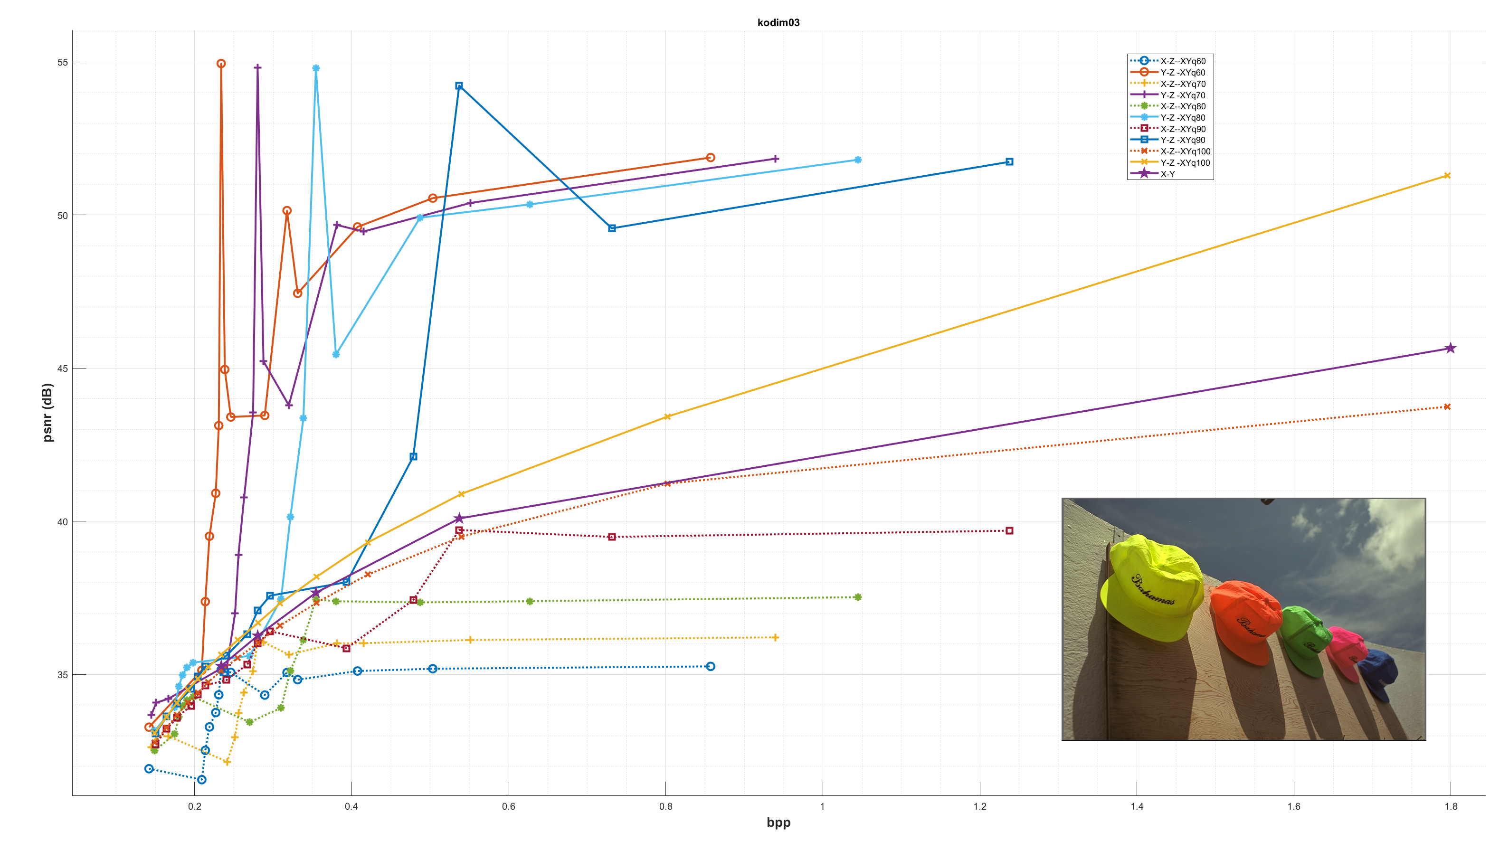
Results
X (raw)
libjpegturbo
.jpg
libjpegturbo
Y (raw)
libjpegturbo
.jpg
libjpegturbo
Z (raw)
cjpeg.exe (Q)
djpeg.exe
cjpeg.exe (Q)
djpeg.exe
Metrices X-Y
Metrices Y-Z
Metrices X-Z

Slide 6
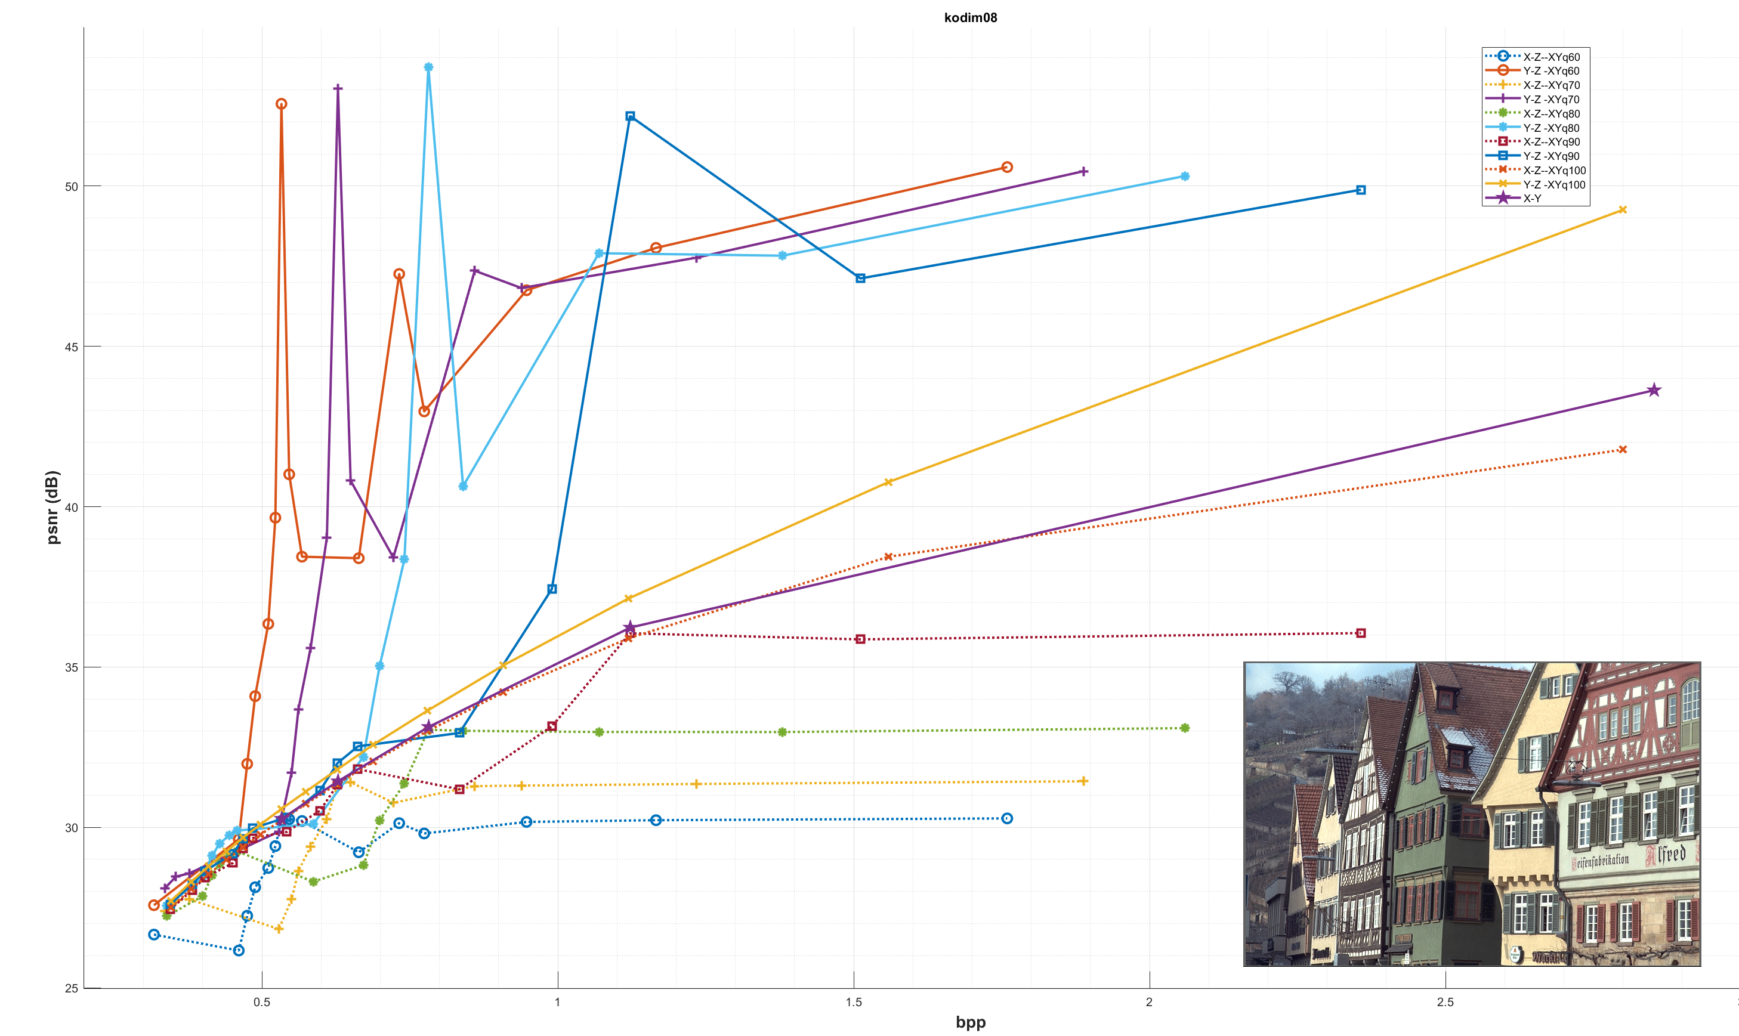
Results
X (raw)
libjpegturbo
.jpg
libjpegturbo
Y (raw)
libjpegturbo
.jpg
libjpegturbo
Z (raw)
cjpeg.exe (Q)
djpeg.exe
cjpeg.exe (Q)
djpeg.exe
Metrices X-Y
Metrices Y-Z
Metrices X-Z

Slide 7
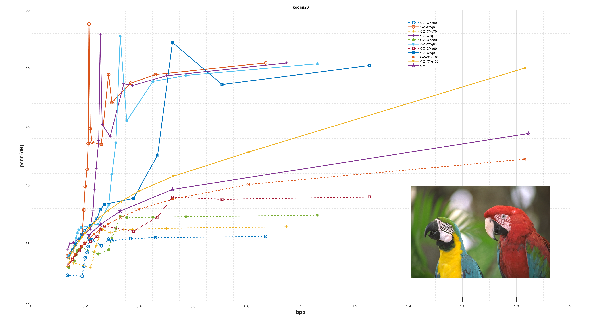
Results
X (raw)
libjpegturbo
.jpg
libjpegturbo
Y (raw)
libjpegturbo
.jpg
libjpegturbo
Z (raw)
cjpeg.exe (Q)
djpeg.exe
cjpeg.exe (Q)
djpeg.exe
Metrices X-Y
Metrices Y-Z
Metrices X-Z

Slide 8
Discussion
PSNR Results in X-Y compression doesn’t go above 46dB.
PSNR Results in Y-Z compression goes above 50dB.
PSNR Results in X-Z compression remains under 40dB and become saturated for the Q-values greater than Q-value of X-Y compression.
Highly fluctuated and irregular PSNR plot.
Irregular bpp values

Slide 9

Conclusion
I belief that :
Using already lossy compressed images should not be used for flicker test.
My Suggestion is to use on of the following test sets.
Kodak test images
JPEG AI test images
JPEG AIC3 test images

Slide 10
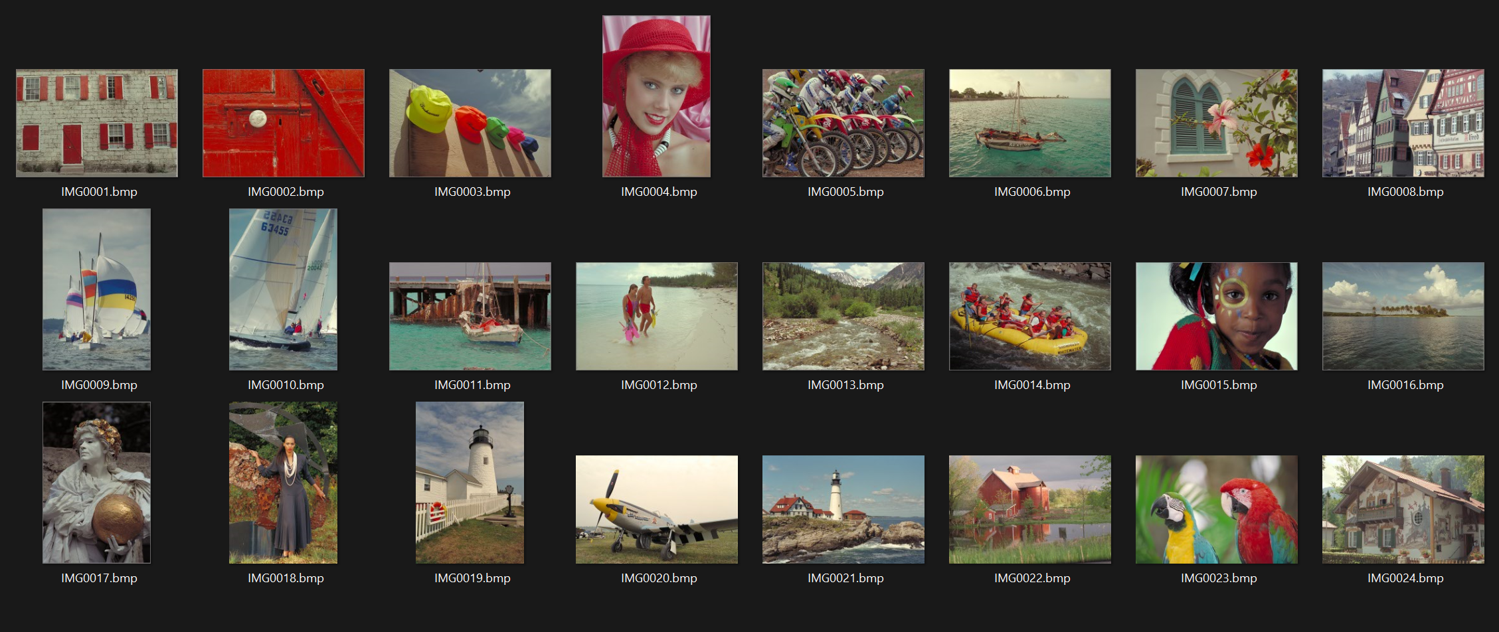
Kodak Test Images

Slide 11
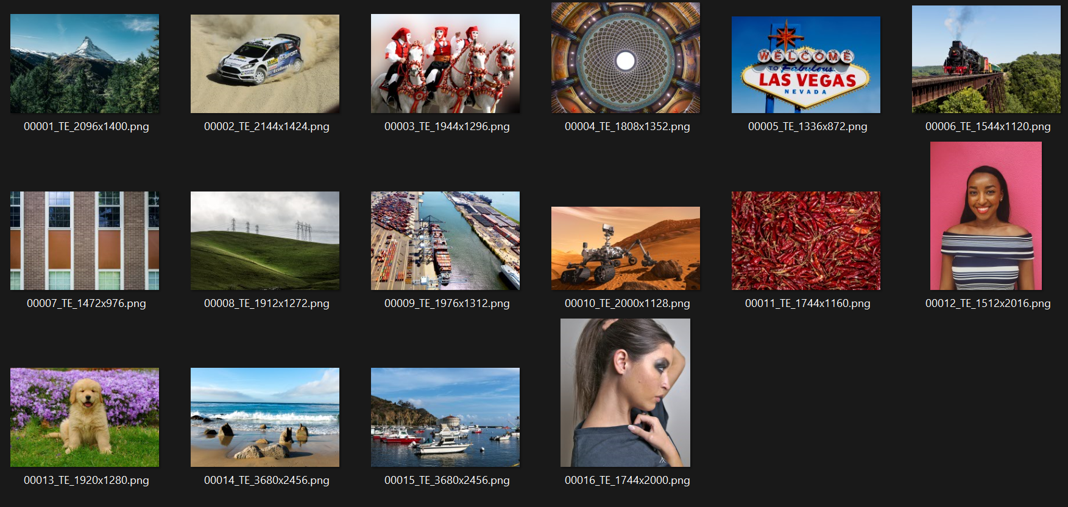
JPEG AI test Images

Slide 12
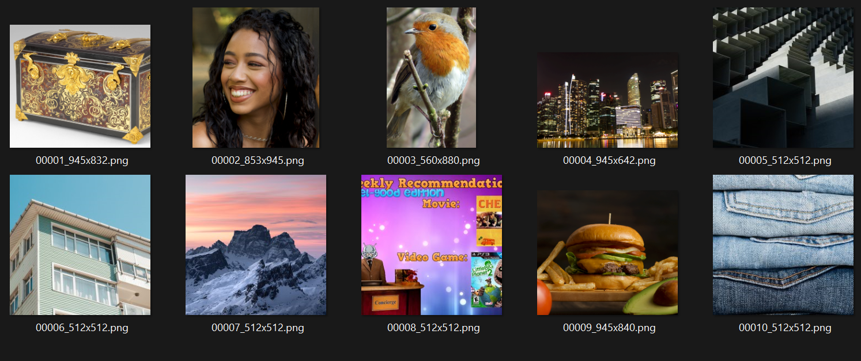
JPEG AIC3 Test images

